Slide 1
Investigating Vertical Alignment and
Math Practices 7 & 8 in Geometry
Notes:
Slide 1: Title Slide
Step-By-Step Instructions:
Have participants sit with colleagues who are from different grade levels. It would be ideal to have groups that have one teacher from each grade level, K-5.

Slide 2
Objectives
To deepen our understanding of the alignment of geometry concepts and how the CA Math Content Standards provide focus, coherence, and rigor in the Geometry (G) domain.
Strengthen understanding of Standards for Mathematical Practice 7 and 8 by identifying and describing these practices in rich mathematics tasks.
Notes:
Slide 2: Objectives
Time Allotted
1 minutes
Step-By-Step Instructions
Ask participants to read the learning expectations.
Before moving to the next slide, point out the “Parking Lot” poster (that you made in advance and posted in the room). Let participants know that if they have any questions throughout the session, they can write it on a sticky note and place it on the Parking Lot. Tell them that you will address those questions as time allows or, if you don’t know the answer, pass those questions on to someone else to address.

Slide 3
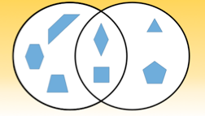
Math Learning Experience
How could you accurately label the category for each circle in the Venn Diagram?
Notes:
Slide 3: Math Learning Experience
Time Allotted
5 minutes
Critical Point
Identifying and understanding the relationship between shapes and their properties is a critical skill for elementary students to prepare them for middle and high school geometry.
Step-By-Step Instructions
Display the question on the slide.
Tell participants:
For this quick task, you are to use what you know about the shapes in the Venn Diagram to determine the category for each of the circles.
Take a minute to think about it independently.
After 1 minute, invite participants to discuss their thinking with their group members.
Allow a few minutes for table-group discussion.
Ask a few groups share their thinking. You are looking for the following answers during this discussion:
[The left circle represents shapes that have parallel lines.]
[The right circle represents shapes that are equilateral.]

Slide 4
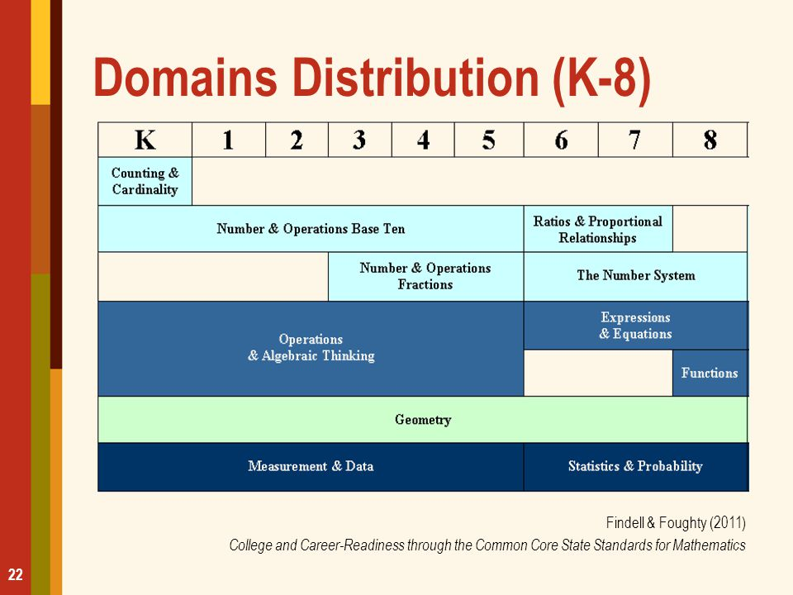
Math Domains
Notes:
Slide 4: Domain Progression
Time Allotted
1 minute
Step-By-Step Instructions
“Today we will investigate vertical alignment in the Geometry domain. As you can see in this table, the Geometry domain starts with Kindergarten and goes all the way to grade 8.”

Slide 5
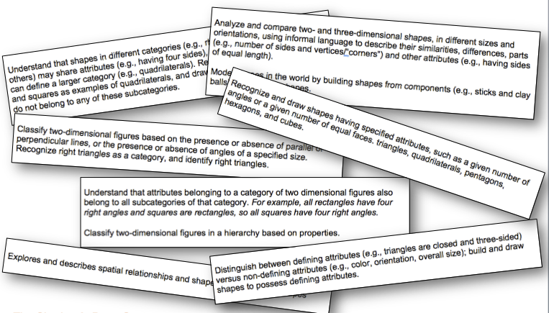
Big Idea: Identify and categorize shapes based on their properties
Notes:
Slide 5: Big Idea
Time Allotted: 15 minutes for slides 5 & 6
Critical Point
The power of this process is the collaborative conversation. It is not about just placing the standards in order or filling out the chart. The process is intended to capture the conversation
and common understandings.
Step-By-Step Instructions: Tell participants:
We are going to engage in a study of the geometry standards using a modified version of the Vertical Alignment process
Pass out a sheet of chart paper and a set of Geometry standards cards for each group. (The standards cards are labeled Facilitator Materials - Geometry Standards Cards. Prior to the session, a set of cards should be copied on cardstock, cut apart, and placed in a plastic bag, or clipped together, for each group.)
Tell participants:
For our study, we will be looking at Geometry standards related to the Big Idea “Identify and categorize shapes based on their properties.”
Your group has a set of the selected standards that have been cut apart, with each card containing the actual language of one or more of the standards from PK to grade 5.
Your group’s task is to read each of these standards and determine the order of the standards statements, from prekindergarten to grade 5. (CONTINUED)

Slide 6
Big Idea: Identify and categorize shapes based on their properties
Notes:
Slide 6: Big Idea
Step-By-Step Instructions Continued
You will notice that the grade-level and standard coding are not listed with the standards.
Your group’s task is to read each of these standards and determine the order of the standards statements, from prekindergarten to grade 5.
As you read and discuss the standards statements, think about how the language describes how skills increase in complexity.
While you work, your group should discuss where you think each standard falls in the PK–5 progression, and determine what language from each of the standards helped you determine its placement.
Be prepared to share and justify your placement of the standards with the whole group when time is up.
Allow 8 to 10 minutes for tables to discuss and place their standards in order.
When it looks like groups have completed the task, call participants back to the whole group.
Ask, “How did the language of the standards help you to place them into a progression?”
Have participants share a few specific examples of language from the standards that helped them to determine their placement.
Transition to next slide to reveal the actual order of the standards, from prekindergarten to grade 5.
Words of Wisdom
Move around groups, monitoring conversations

Slide 7
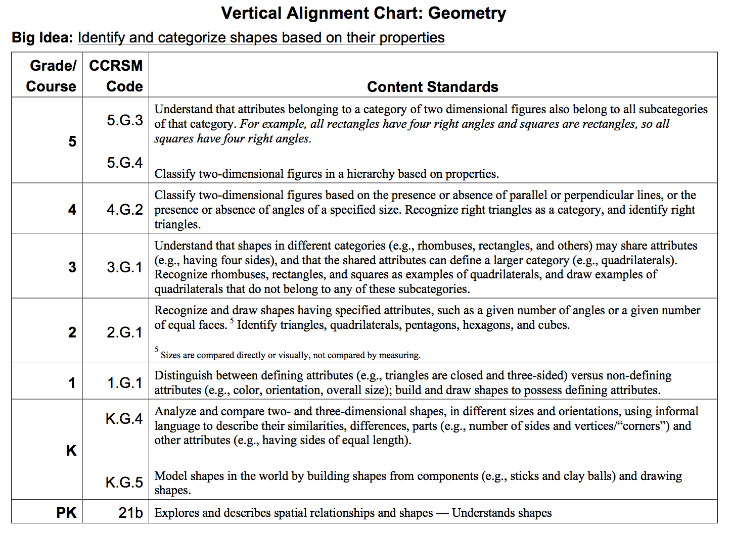
Big Idea: Identify and categorize shapes based on their properties
Notes:
Slide 7: Big Idea
Time Allotted
10 minutes
Step-By-Step Instructions
Pass out and have groups compare their placement of the standards to the vertical alignment displayed on Hand Out #1: Vertical Alignment Chart: Geometry
Give participants a few minutes to make any changes to their placement of the standards, then have them glue the standards on the left side of the chart paper. They should label each standard with its corresponding grade level and standard code, and leave space between each standard so that they can write some observations during the next step of this activity.
Quickly debrief this section by asking,
Were there any standards that you thought were intended for one grade level but then had to move?
What language in that standard do you think makes it fit with its intended grade level?

Slide 8
Investigating Vertical Alignment
As a group, analyze the trajectory, considering the following questions:
  What changes occur from grade to grade?
  Where are concepts introduced, developed, and finalized?
  Does an idea or skill get more complex, and if so, how?
Notes:
Slide 8: Investigating Vertical Alignment
Time Allotted
8 minutes
Step-By-Step Instructions
Have table groups record their answers to the questions on the right side of the chart. Tell participants that they may want to record additional observations and findings that surfaced during their discussions.
Allow time for table groups to share a few of their findings with the whole group.
Ask participants to return to their seats and have a short discussion about the shifts (focus, coherence, and rigor). Ask, “How did these key shifts surface during this learning experience?”

Slide 9
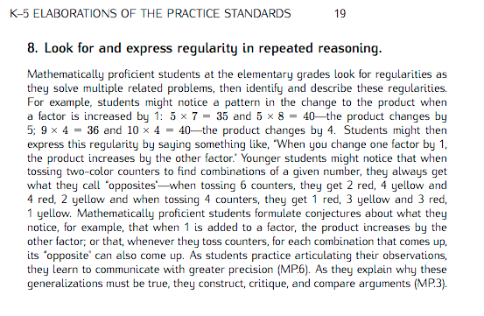
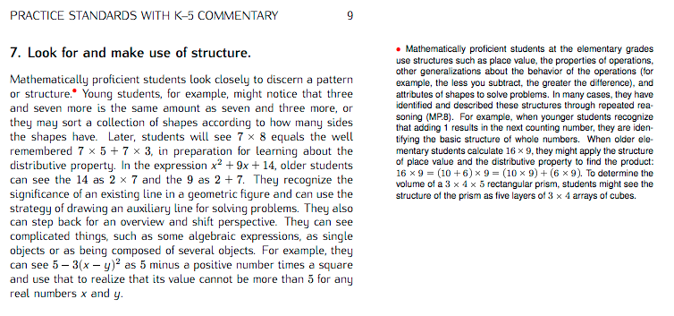
Looking for Evidence of the Math Practices
While you are reading, think about the following questions:
How will students engage in the mathematics through each of these SMPs?
What similarities do you see in student behaviors/actions as described in SMPs 7 and 8? What differences do you see?
Notes:
Slide 9: Looking for Evidence of the Math Practices
Time Allotted: 10 minutes
Critical Point
Rigorous mathematics teaching and learning should intentionally integrate the Standards for Mathematical Practice with mathematics content.
Step-By-Step Instructions: Tell participants:. For this session, we will focus on SMPs 7 & 8. It is important to note that we are not expecting you to be experts on these two SMPs. This will be an ongoing conversation.
Pass out Hand Out #2 Standards for Mathematical Practice: Commentary and Elaborations for K–5.
Tell participants: Remember, the Commentary and Elaborations document for K–5 adapts the language of the SMPs in two different ways:
the annotated version of the standards provides additional interpretation of the standards appropriate for the K–5 classroom.
the elaborations of the standards are narrative descriptions that integrate the annotations and provides a coherent description of how the SMPs play out in the K–5 classroom.
Take a few minutes to read through either the Commentary version or the Elaboration version for both SMP 7 and SMP 8.
While you are reading, think about how students would engage in each of these SMPs and compare the similarities and differences among the student behaviors for each of these two SMPs.

Slide 10
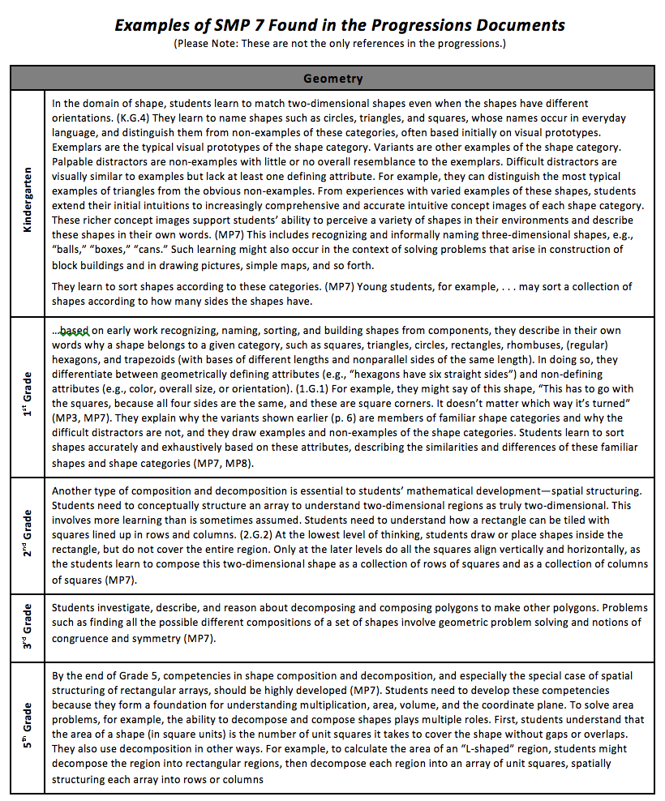
Looking for Evidence of the Math Practices
Use the handout to discuss:
How will students engage in the mathematics through each of these SMPs?
Similarities?
Differences?
Notes:
Slide 10: Looking for Evidence of the Math Practices
Time Allotted
5 minutes
Step-By-Step Instructions
Pass out Hand Out #3: SMP 7&8 in Geometry
Read the handout.
Have groups share out some of the student behaviors/actions that they expect to see for SMPs 7 & 8 in the content area of Geometry. Some possible responses include:
SMP 7
Students will observe and identify shapes in the real world.
Students will identify defining attributes of shapes.
Students will compose and decompose shapes.
SMP 8
Students sort and classify shapes based on attributes.
Student describe similarities and differences between shapes and shape categories.
Students develop formulas based on repeated reasoning of how to calculate in order to solve problems, such as those involving area and perimeter.

Slide 11
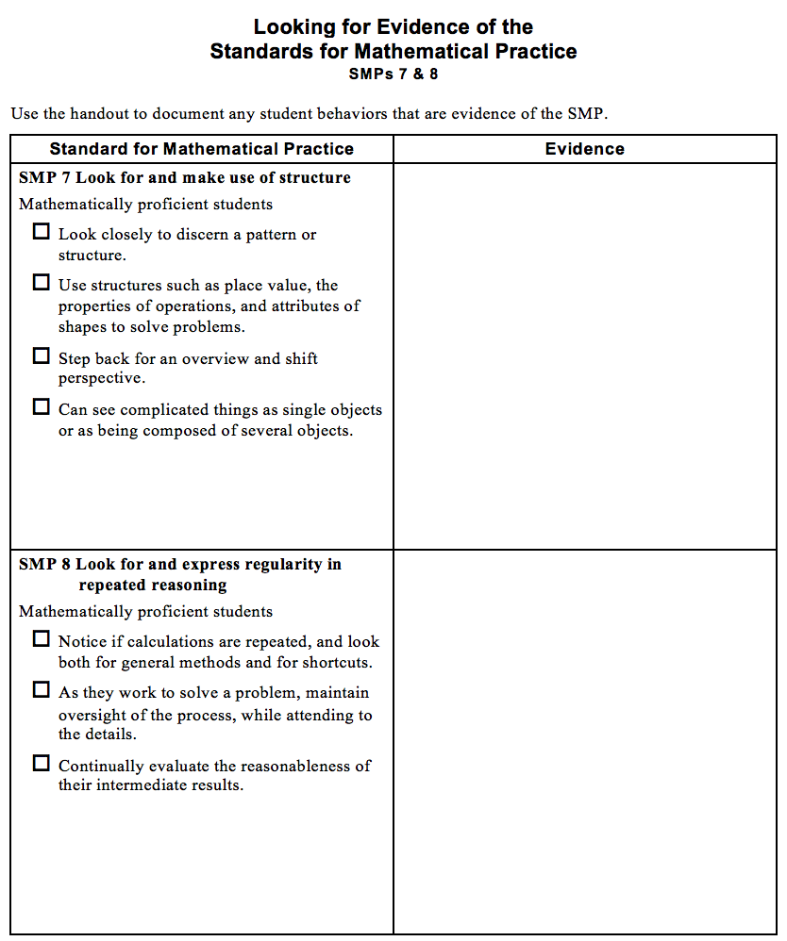
Looking for Evidence of the Math Practices
Use this handout to:
Check off actions during task
Record observations during task
Notes:
Slide 11: Looking for Evidence of the Math Practices
Time Allotted
2 minutes
Step-By-Step Instructions
Tell participants: We want to give you an opportunity to think about and observe the actions and behaviors described in the SMPs.
You will be looking for evidence of the student behaviors described in SMPs 7 & 8 as you engage in a mathematical task.
In order to help you with this experience, we have a tool that will help you look for and document evidence of engagement in these SMPs.
Pass out Hand Out 4 - Looking for Evidence of SMPs 7 & 8
Read the directions on the slide:
The left-hand column contains the narrative description of one or more SMPs with check off boxes.
The right-hand column should be used to document observations of any specific evidence for the descriptors checked off in the left-hand column.
They will be filling it in for themselves after a math task.

Slide 12
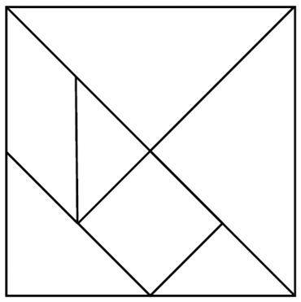
Math Learning Experience: Tangrams
A tangram is an ancient geometric
puzzle with 7 shapes:
2 large triangles
1 medium triangle
2 small triangles
1 square
1 parallelogram
Notes:
Slide 12: Math Learning Experience: Tangrams
Time Allotted
5 minutes
Step-By-Step Instructions
Tell participants: Tangram is an ancient puzzle that is created when a large square (for our purposes, a square of paper) is decomposed into several smaller shapes:
2 large triangles,
1 medium triangle,
2 small triangles,
1 square, and
1 parallelogram.
Pass out a Tangram puzzle to each participant HO#5 Tangram Puzzles. Note : two puzzles per sheet; give each participant only one Tangram puzzle. And remember: do NOT cut the puzzle pieces out for participants ahead of time.
Ask participants to quickly cut out all the pieces of their Tangram puzzle.
When participants finish cutting apart their puzzles, and while they wait for others to finish, ask them to attempt to reconstruct the original square with their seven Tangram pieces.
Inform the participants that the learning is intended to be mostly on a grade 1 level, and it will provide us with math vocabulary for the next task.

Slide 13
Math Learning Experience: Composing Shapes
Using only the 2 small triangles:
Make a square
Make a larger triangle
Make a parallelogram
Notes:
Slide 13: Math Learning Experience: Composing Shapes
Time Allotted
5 minutes
Critical Point
Composing and decomposing shapes using other shapes is a foundational skill taught in primary grades that is necessary for understanding area concepts in upper elementary grade levels.
Step-By-Step Instructions
Once the participants have had a couple of minutes to work with their tangram pieces to recreate the square, ask them to set aside all the shapes except for the two smallest triangles.
Tell participants:
We are going to work first with these two shapes to compose other shapes.
The rule for creating a new shape with tangram shapes is that you must position the shapes so that their edges are touching with no overlaps or gaps.
Begin by making a square using only the two small triangles.
Allow 10 to 15 seconds for participants to create a square.
Using the same 2 small triangles, create a larger triangle.
Allow 10 to 15 seconds for participants to create the larger triangle.
Now, make a parallelogram using the same 2 small triangles.
Allow 10 to 15 seconds for participants to create the parallelogram.
Words of Wisdom
Some participants may struggle with the spatial reasoning for making more complicated shapes, so allow them to help each other as necessary.

Slide 14
Math Learning Experience: Composing Shapes
Using only 2 small triangles and the square:
Make a triangle
Make a trapezoid
Make a parallelogram
Make a rectangle
Notes:
Slide 14: Math Learning Experience: Composing Shapes
Time Allotted
2 minutes
Step-By-Step Instructions
Tell participants:
Now use the two smaller triangles AND the square to compose some larger shapes.
Begin by making a large triangle using the two small triangles and the square.
Allow 20 to 30 seconds for participants to create the larger triangle.
Now create a trapezoid using the 2 small triangles and the square.
Allow 20 to 30 seconds for participants to create the trapezoid.
Next, use the 2 small triangles and the square to make a parallelogram.
Allow 20 to 30 seconds for participants to create the parallelogram.
Now make a rectangle using the 2 small triangles and the square.
Allow 20 to 30 seconds for participants to create the rectangle.
Transition to the next slide.

Slide 15
Math Learning Experience: Composing Shapes
Using only 2 small triangles and the medium triangle:
Make a triangle
Make a trapezoid
Make a parallelogram
Make a rectangle
Notes:
Slide 15: Math Learning Experience: Composing Shapes
Time Allotted
3 minutes
Step-By-Step Instructions
Tell participants:
Next, you will use the two smaller triangles AND the medium triangle to compose some larger shapes.
Begin by making a large triangle using only the two small triangles and the medium triangle.
Allow 30 to 45 seconds for participants to create the large triangle.
Tell participants, “Now create a trapezoid using the 2 small triangles and the medium triangle.”
Allow 30 to 45 seconds for participants to create the trapezoid.
Tell participants, “Next, use the 2 smaller triangles and the medium triangle to make a parallelogram.”
Allow 30 to 45 seconds for participants to make the parallelogram.
Tell participants, “Last, make a rectangle using the 2 smaller triangles and the medium triangle.”
Allow 30 to 45 seconds for participants to make the rectangle.
Transition to the next slide.

Slide 16

Classifying Quadrilaterals
What do these two figures have in common?
What is different?
What larger category would these figures fit into?
Notes:
Slide 16: Classifying Quadrilaterals
Time Allotted
2 minutes
Critical Point
Students do not always see the relationships between shapes and their attributes even after you have taken the time to define them. It is important that teachers are intentional about pointing out these relationships so that students can start to progress in their level of geometric thinking.
Step-By-Step Instructions
Tell participants:
Now that we have identified a number of attributes of different quadrilaterals, let’s look for some relationships between the shapes and their attributes.
Look at these 2 figures.
With your partner, take a minute to discuss what these two figures have in common and what is different about them.
Allow a minute for discussion.
Have participants share out some observations on the similarities and differences between the two shapes on this slide.

Slide 17

Classifying Quadrilaterals
What do these two figures have in common?
What is different?
What larger category would these figures fit into?
Notes:
Slide 17: Classifying Quadrilaterals
Time Allotted
3 minutes
Step-By-Step Instructions
Tell participants, “Look at these 2 figures. With your partner, take a minute to discuss what these two figures have in common and what is different about them.”
Allow a minute for discussion.
Have participants share out some observations on the similarities and differences between the two shapes on this slide.

Slide 18

Classifying Quadrilaterals
What are these shapes?
Notes:
Slide 18: Classifying Quadrilaterals
Time Allotted
2 minutes
Step-By-Step Instructions
Ask participants, “Can you tell me the name of these two shapes?”
Some participants may struggle with calling the second shape a Trapezoid.

Slide 19
Classifying Quadrilaterals
Trapezoids
Exclusive Definition: Quadrilateral with exactly one pair of parallel lines
Inclusive Definition: Quadrilateral with
at least one pair of parallel lines
Notes:
Slide 19: Classifying Quadrilaterals
Time Allotted
5 minutes
Step-By-Step Instructions
Tell participants:
While 1 pair of parallel sides is often the agreed-upon definition of a trapezoid, it really depends on where you are from and what system you are using.
There are actually two different definitions for a Trapezoid used in the world.
One is the exclusive definition. In this definition, a Trapezoid has EXACTLY one pair of parallel sides, much like these two examples on the slide.
The other definition is called the inclusive definition. In this definition, a trapezoid must have AT LEAST one pair of parallel sides.
According to the California Standards, we are to use the inclusive definition when teaching these standards.
How does the use of the inclusive definition affect how we might classify other quadrilaterals?
Take a few minutes to discuss this idea with your group.
Allow a couple of minutes for participants to discuss, and then have them share out some of their thoughts.
Make sure to point out the following ideas, if they don’t come up:
[With the Exclusive Definition, Trapezoids were categorized by themselves as a separate type of quadrilateral that don’t relate to other quadrilaterals.]
[With the Inclusive Definition, Trapezoids include shapes such as Squares, Rectangles, Rhombuses (or Rhombi), and Parallelograms.]

Slide 20
Classifying Quadrilaterals
On chart paper, build a hierarchy of quadrilaterals that includes the following terms:
Square
Rectangle
Parallelogram
Rhombus
Trapezoid
Quadrilateral
Document the properties that you used to create the hierarchy, and draw an example of each shape.
Notes:
Slide 20: Classifying Quadrilaterals
Time Allotted: 20 minutes
Step-By-Step Instructions: Pass out chart paper to each group.
Tell participants:
Now that we have explored the different kinds of quadrilaterals and their attributes, you will work with your group to create a visual hierarchy of these different quadrilaterals.
Using chart paper, you and your group need to organize these shapes into a hierarchy that visually shows that you understand each shape’s position in the hierarchy of quadrilaterals.
For this hierarchy, your group should organize these shapes according to inclusiveness. For example, we all agree that all squares are a specific type of rectangle, but that there are other rectangles that are not squares. So rectangles would then be higher up on the hierarchy because rectangles include all squares plus other shapes outside of squares.
Say: In your visual, you should also include a drawing of each shape and a list of the properties you used to determine each shape’s place in the hierarchy.

Slide 21
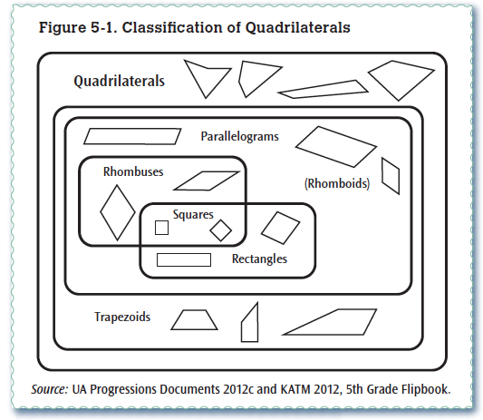
CA Math Framework
Here is the hierarchy included in the Grade 5 California Math Framework, Grade 5, page 266:
Notes:
Slide 21: CA Math Framework
Time Allotted
2 minutes
Critical Point
States select the definition for trapezoid. California selected the inclusive definition, at least one pair of parallel lines. The inclusive definition is helpful in higher level math.
Step-By-Step Instructions: Pass out chart paper to each group.
Tell participants:
LAUSD will be using the inclusive definition, as that is what is in the California Framework. Please pass out HO# 6

Slide 22
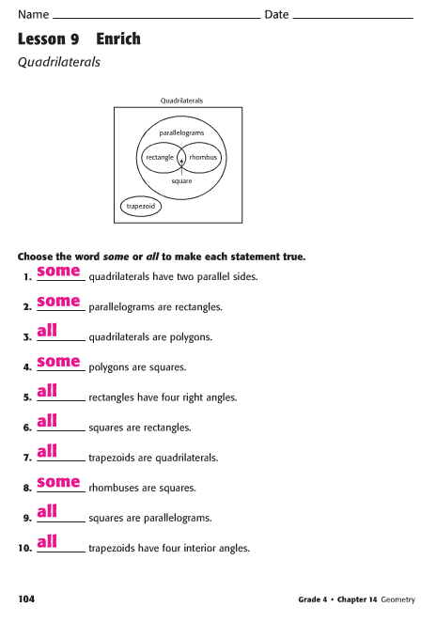
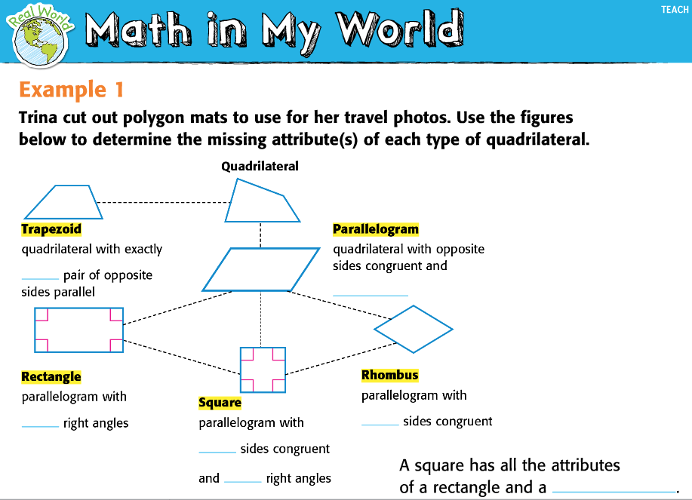
My Math and Trapezoids
My Math uses the exclusive definition of trapezoids.
Notes:
Slide 22: My Math and Trapezoids
Time Allotted
2 minutes
Step-By-Step Instructions
The “Trapezoid Wars” are an example of how math can change over time. Each state has selected the trapezoid definition it will use. My Math uses the exclusive definition. That means that we will need to supplement the Grade 4 and Grade 5 lessons in the Geometry chapters. Additional resources are included in the curriculum maps. Engage NY/Eureka resources use the inclusive definition.
Words of Wisdom
People teach the way that they were taught, and most of our teachers learned the exclusive definition. This will mean a change in their content knowledge and will result in some disequilibrium.

Slide 23
Looking for Evidence of the Math Practices
Use this handout to:
Check off actions during task
Record observations during task
Notes:
Slide 23: Looking for Evidence of the Math Practices
Time Allotted
5 minutes
Step-By-Step Instructions
Remind participants that they were asked use this handout (P-04 Looking for Evidence of the Standards for Mathematical Practice: SMPs 7 & 8) to document evidence of their own engagement in SMPs 7 & 8 throughout the tasks. Give participants a couple minutes to revisit this page and discuss in their groups the evidence they noticed of their own engagement in these SMPs during the task we just completed.
Have a few participants share out their observations.
Words of Wisdom
Possible evidence of SMPs 7 and 8 that may surface from the activity:
SMP 7: We explored the structure of quadrilaterals and used specific attributes to define shapes and their categories.
SMP 8: We used the defining attributes of the shapes to look for relationships between shapes and to categorize shapes into categories and subcategories.

Slide 24

Teaching and Learning Framework
Standard 1a1: Knowledge of Content and the Structure of the Discipline
Standard 3a4: Use of Academic Language
Notes:
Slide 22: Teaching and Learning Framework
Time Allotted
1 minute
Step-By-Step Instructions
Make connections to the Teaching and Learning Framework, specifically Standards 1a1: Knowledge of Content and the Structure of the Discipline and Standard 3a4: Use of Academic Language.
Ask participants where they saw connections to the Teaching and Learning Framework.

Slide 25
Reflection
How does studying standards across grade levels influence what I do in my classroom?
How does studying the standards in this way support my understanding of the key shifts of coherence, focus, and rigor?
Notes:
Slide 23: Reflection
Time Allotted
5 minutes
Step-By-Step Instructions
Give participants about 1 minutes to reflect individually and silently about the questions on the slide, then have them discuss the questions with those at their tables.
After about 2 minutes, ask groups to share out a few of their conversation points.
Some of the important ideas that could be surfaced include:
#1 — It is important that we, as teachers, spend collaborative time studying the standards to ensure horizontal and vertical alignment. In addition, studying the standards can be used as a structure that supports differentiation and allows us to fill gaps in student learning.
#2 — Investigating how a big idea changes and grows across multiple grade levels speaks to the coherence of the standards. This investigation helps educators determine the grade level(s) at which the big idea is a critical area of focus. In addition, studying the standards helps educators determine the grade levels at which rigor—conceptual understanding, procedural skills, and fluency—is developed.
Remove one of the strips from the Geometry trajectory chart and ask, “What happens if a teacher decides not to teach one or more standards?” Popcorn some responses.
Summarize by reminding participants that studying the standards is a continuous journey, and alignment is an ideal state.
Reiterate the need for common understanding of the CA Math Content Standards, and that school-wide studying of the standards is one of a number of steps towards district-wide implementation of the CA Math Content Standards.
Thank the participants for their participation.

